Slide 1
CHALLENGING BEHAVIORAL HEALTH ISSUES IN PEDIATRICS: PSYCHIATRIC CONSULTATION
When:
June 13, 2024
12:00 PM – 1:00 PM

Slide 2
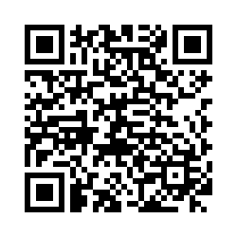
Pre-Presentation Survey

Slide 3
SPEAKERS
D. Paul Robinson, MD, FAAP, Faculty, Tallahassee Memorial Family Medicine Residency Adolescent Clinic and the Tallahassee Memorial Hospital Behavioral Health Center
Saundra Stock, MD, Chief, Division of Child and Adolescent Psychiatry, Psychiatry and Behavioral Neurosciences at the University of South Florida
Heather A. Flynn, Ph.D., Professor and Chair, Department of Behavioral Sciences and Social Medicine at the Florida State University College of Medicine, Director of the FSU Center for Behavioral Health Integration
Mary P. Norton, MD, FAAP, General Pediatrician at Tallahassee Pediatrics, Pediatric Content Expert at the FSU Center for Behavioral Health Integration

Slide 4
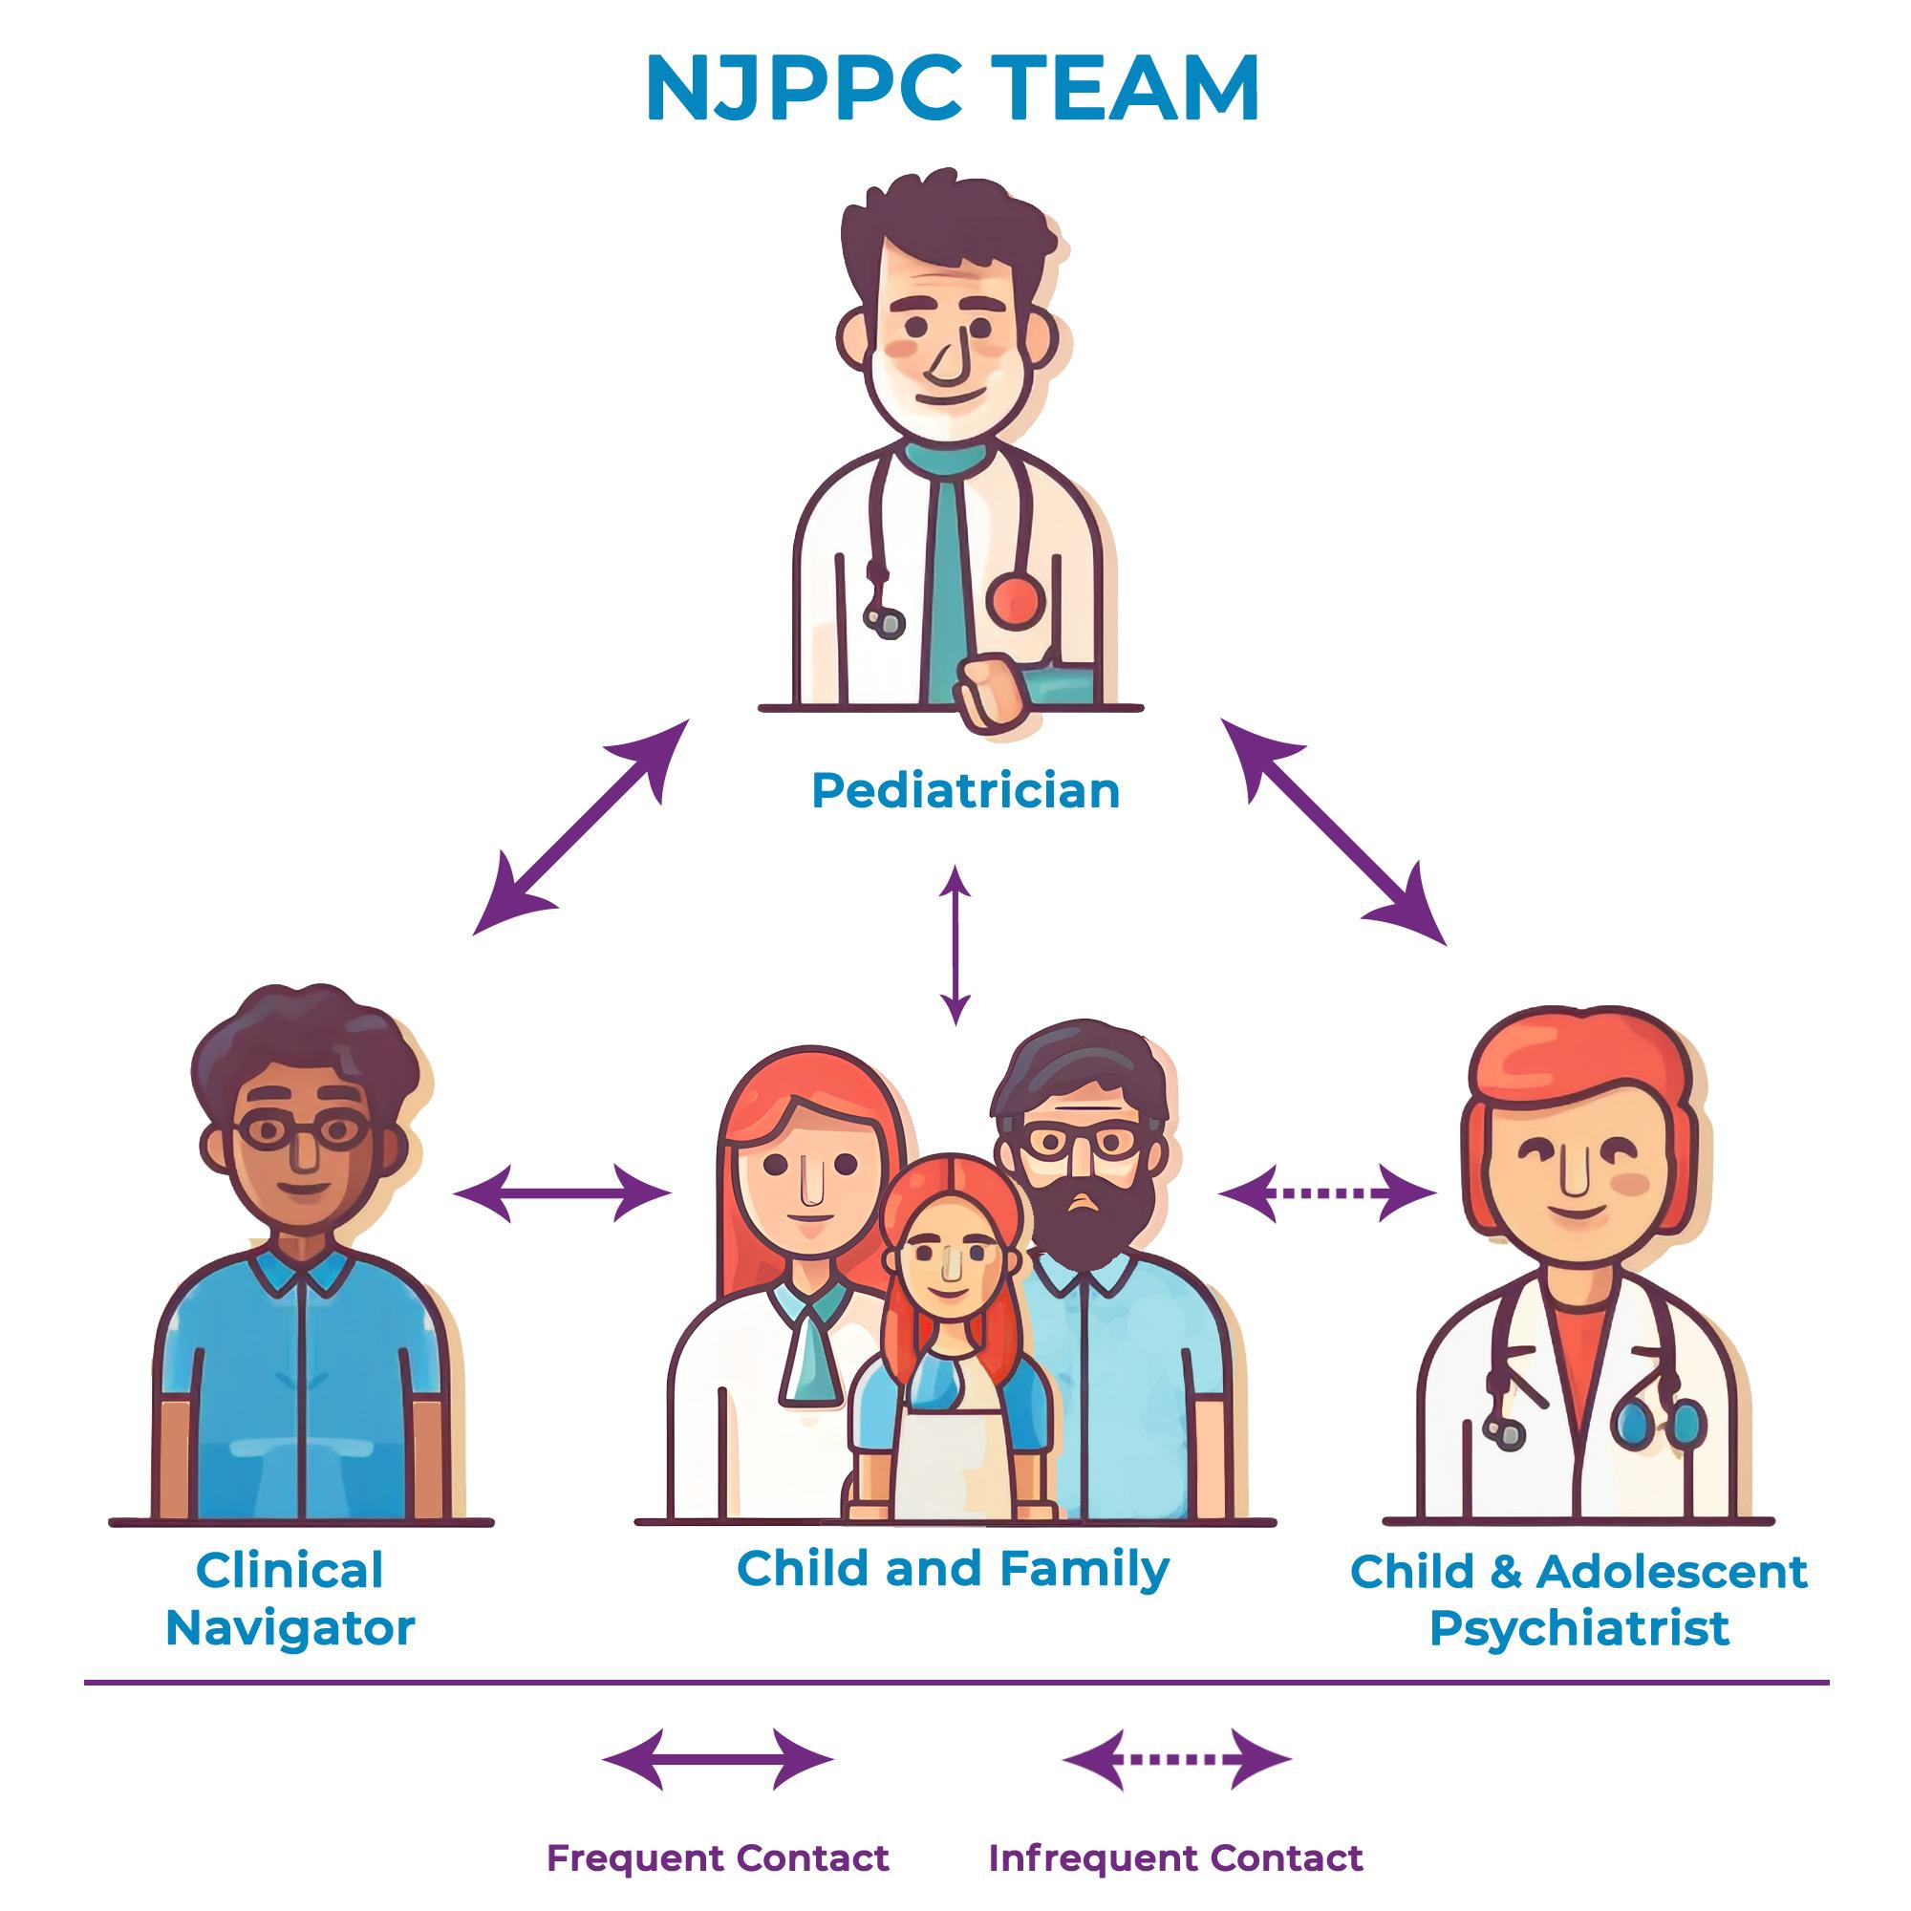
AN OVERVIEW OF THE PSYCHIATRIC CONSULTATION MODEL
New Jersey Pediatric Psychiatry Collaborative (NJPPC) https://www.nj-ppc.org/

Slide 5
HOW TO ACCESS DR. ROBINSON AND/OR DR. STOCK
The USF Child Psychiatry Telephone Consultation Line is available at: 866-487-9507
Open to providers for questions youth with any insurance up to 21 years old.
Calls answered within 24 hours by a child psychiatrist.
If you have a need for behavioral health consultation regarding psychiatric medication management, diagnosis, or any other issue that would benefit from a board-certified adolescent medicine physician, please contact local expert, Dr. Paul Robinson. Please leave him a voicemail and he'll return your call within 24 hours. Dr. Robinson has access to board certified child psychiatrist consultants as well, in the event another level of consultation is needed.
Call Dr. Robinson at: 850-566-4551 - leave a message
You can also fax a referral form to the Hub at: 850-765-9509

Slide 6
BRIEF OVERVIEW OF DR. ROBINSON’S CONSULTATION EXPERTISE
Adolescent Medicine Fellowship
Vanderbilt University Hospital. Finished 1987.
General Pediatrics in Jacksonville and Tallahassee for 9 years total---Carithers Pediatrics (1987-1994) and Tallahassee Pediatrics (2009-2010)
Chief of Division of Adolescent Medicine, University of Missouri, Columbia 1994-2008
Most of the patients seen in clinic had behavioral health issues: anorexia nervosa, depression, anxiety, or behavioral and substance use issues.
CMS clinic with Dr. Mary Beth Seay, Dr. Susan Cross, and Norine Labitsky, A.P.R.N. 2009-2018
We saw many of the children on Medicaid plans who needed behavioral health medications. Many children with difficult to manage ADHD, autism spectrum disorder, and anxiety or depression.
TMH Behavioral Health Clinic 2018-present
Continued seeing many of the children seen at CMS and now seeing other referrals.
Adolescent Medicine Clinic at the TMH Family Medicine Residency 2011-present

Slide 7
CONSULTATION CASE EXAMPLES WITH DR. STOCK
16y/o male on sertraline 200mg for depression with limited effect. How to cross titrate to fluoxetine?
14y/o girl with autism, anxiety and OCD who got “psychotic” after 2 wks on fluoxetine 10mg. Is an SSRI contraindicated? If no, which one to start, what dose and how to titrate. What other meds to consider?
9y/o with ADHD more irritable on Focalin-XR 5mg. Azstarys 26.1mg worsened tics.
Rec MPH-IR 10mg BID + Intuniv 1mg
13y/o male with ADHD, ODD and skin picking on bupropion XL and Concerta 36mg QAM. How to address skin picking?
NAC, habit reversal, behavioral approaches

Slide 8
CONSULTATION CASE EXAMPLES WITH DR. STOCK (CONTINUED)
6 y/o with ADHD cannot swallow pills, but quillivant not lasting long enough. Other options?
18y/o using fentanyl and depressed. What to do?
Suggested Narcan for the household, substance tx, Nar-ANON for family
9y/o male hearing voices telling him to do and things x 2 wks. Afraid to be alone and not sleeping. MGM w/schizophrenia. What to do?
Discussed med options and how to monitor (labs, AIMS)

Slide 9
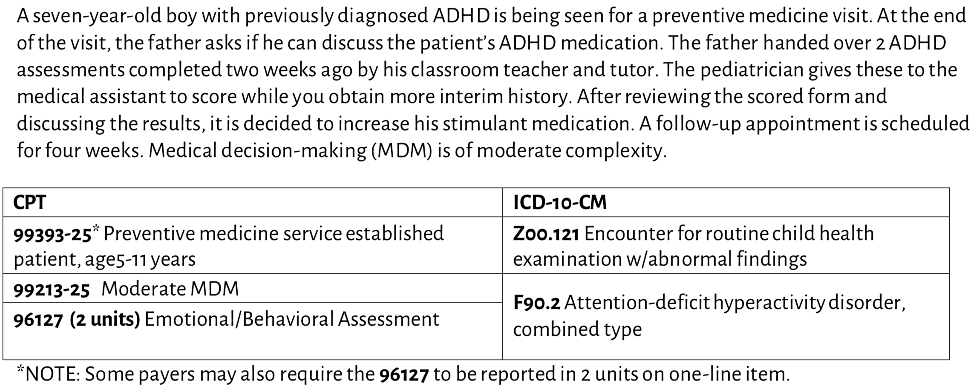
CODING FOR PEDIATRIC BEHAVIORAL HEALTH VIGNETTE #1
*If you call Dr. Robinson or the USF Psychiatric Hotline, you can document additional time spent on your clinical decision making using the 99201-99215 series.
AAP Coding for Standardized Assessment, Screening and Testing 2023
https://downloads.aap.org/AAP/PDF/coding_factsheet_developmentalscreeningtestingandEmotionalBehvioraassessment.pdf?_ga=2.131547215.1122463277.1655087352-974186796.1654882403

Slide 10
CODING FOR PEDIATRIC BEHAVIORAL HEALTH VIGNETTE #2
AAP Coding for Standardized Assessment, Screening and Testing 2023
https://downloads.aap.org/AAP/PDF/coding_factsheet_developmentalscreeningtestingandEmotionalBehvioraassessment.pdf?_ga=2.131547215.1122463277.1655087352-974186796.1654882403

Slide 11
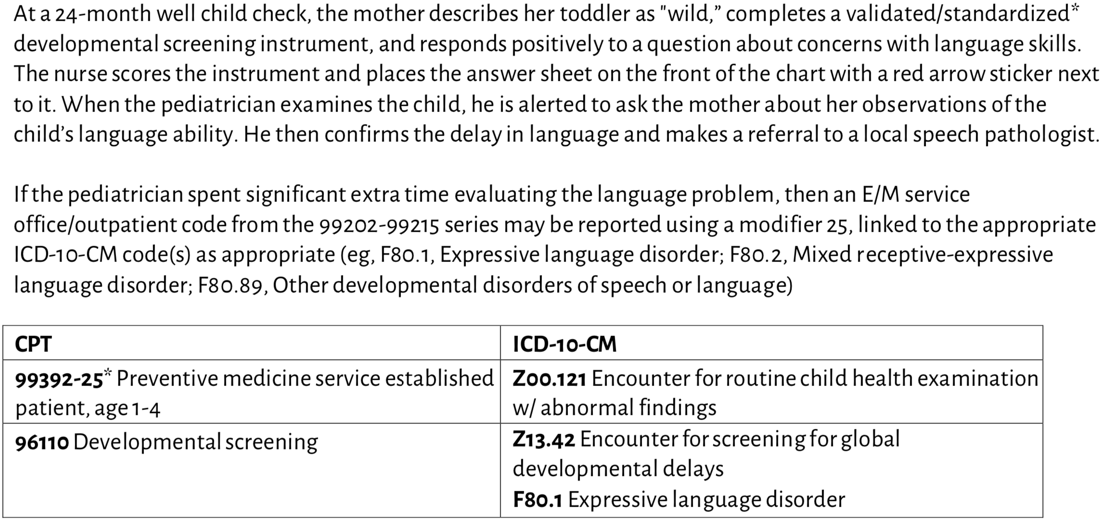
CODING FOR PEDIATRIC BEHAVIORAL HEALTH VIGNETTE #3
AAP Coding for Standardized Assessment, Screening and Testing 2023
https://downloads.aap.org/AAP/PDF/coding_factsheet_developmentalscreeningtestingandEmotionalBehvioraassessment.pdf?_ga=2.131547215.1122463277.1655087352-974186796.1654882403

Slide 12
OPEN FORUM
What are your experiences and/or perceptions of psychiatric consultation?
For which diagnoses/behavioral concerns would collaboration with a child and adolescent psychiatrist be helpful?

Slide 13
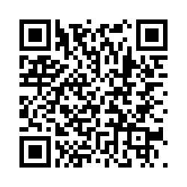
Post-Presentation Survey

