Slide 2
Disclosures
I have no relevant financial relationship with the manufacturer of any commercial product and/or provider of commercial services discussed in this CME activity.
I do intent to discuss an unapproved use of a commercial product/device in my presentation.

Slide 6
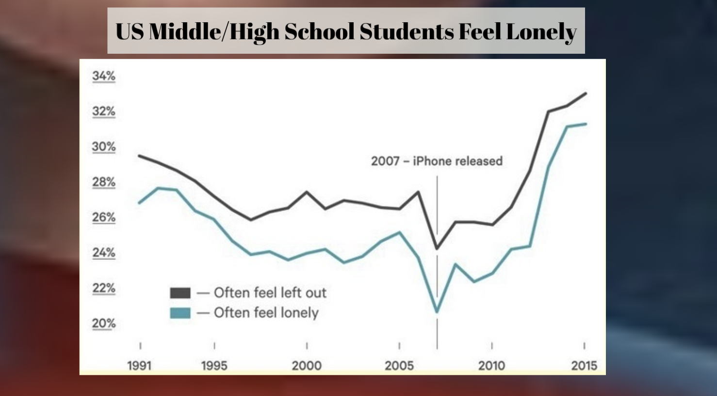

Slide 7
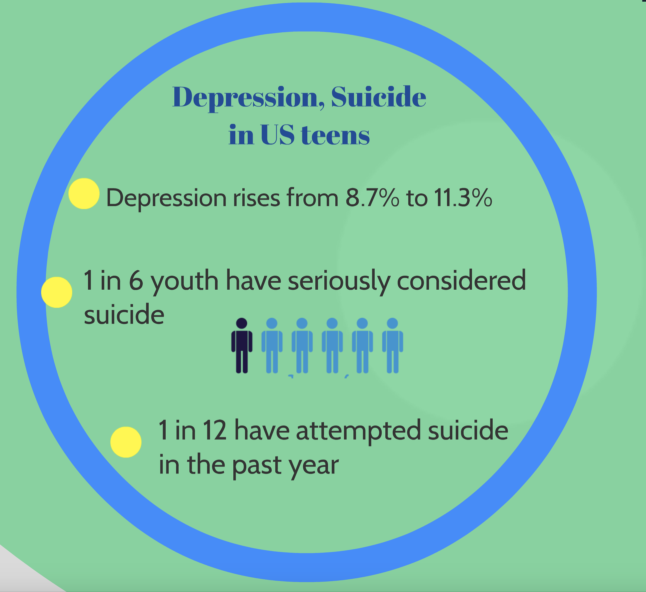

Slide 8
SCREENING
The Patient Health Questionnaire-9 Modified for Adolescents (PHQ-A)

Slide 9
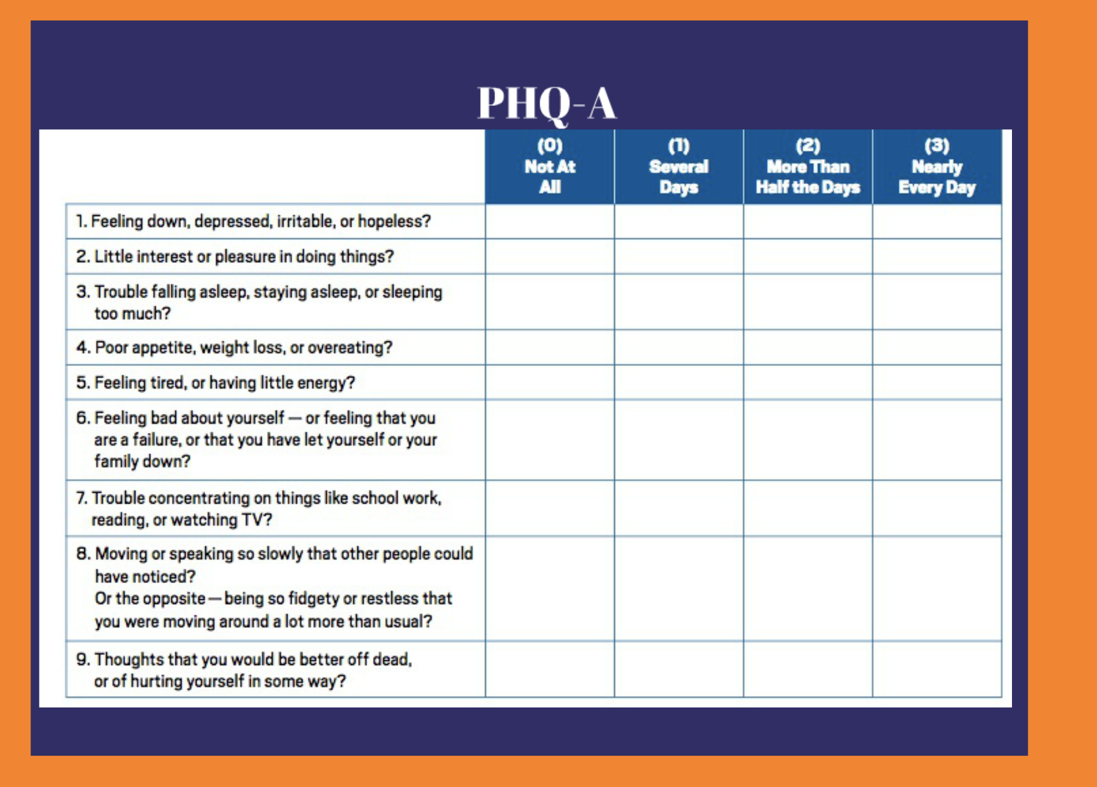

Slide 10
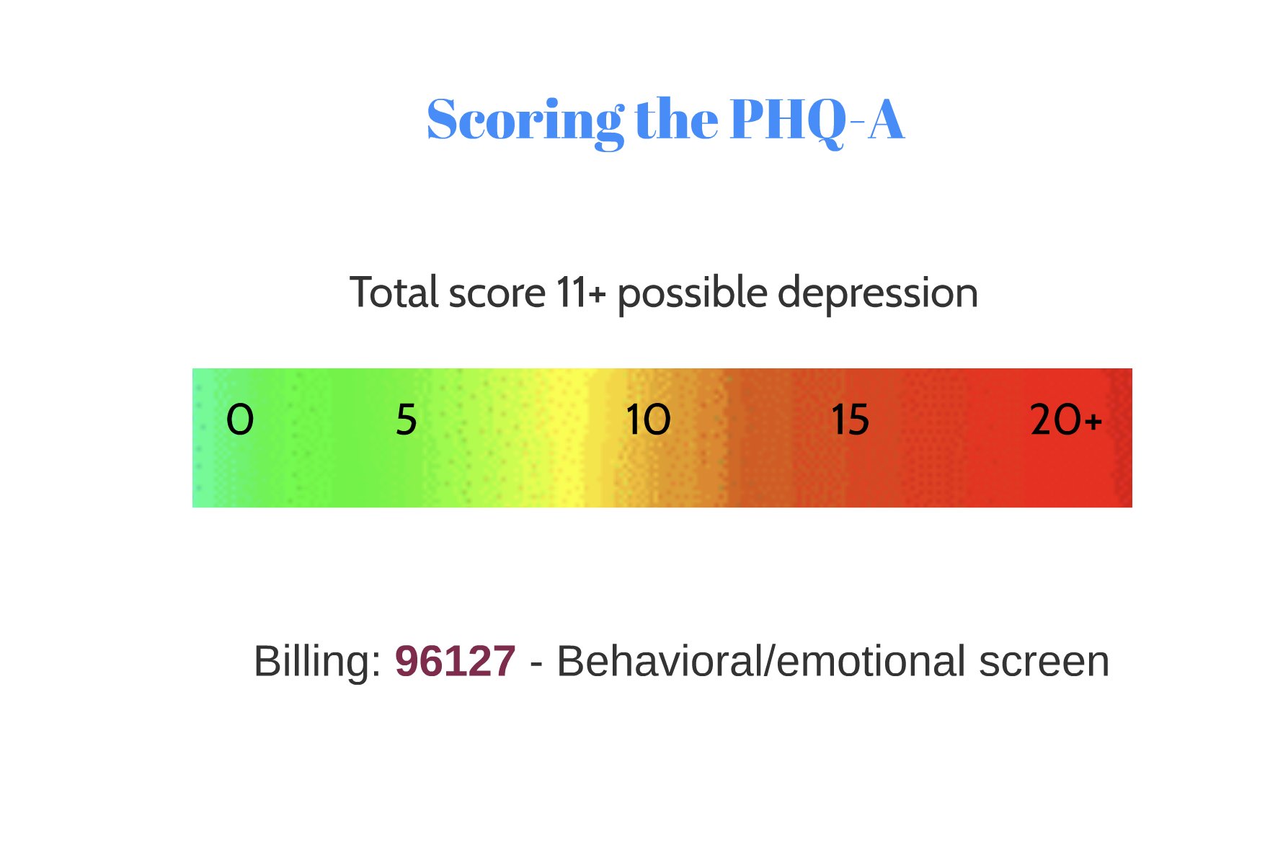

Slide 23
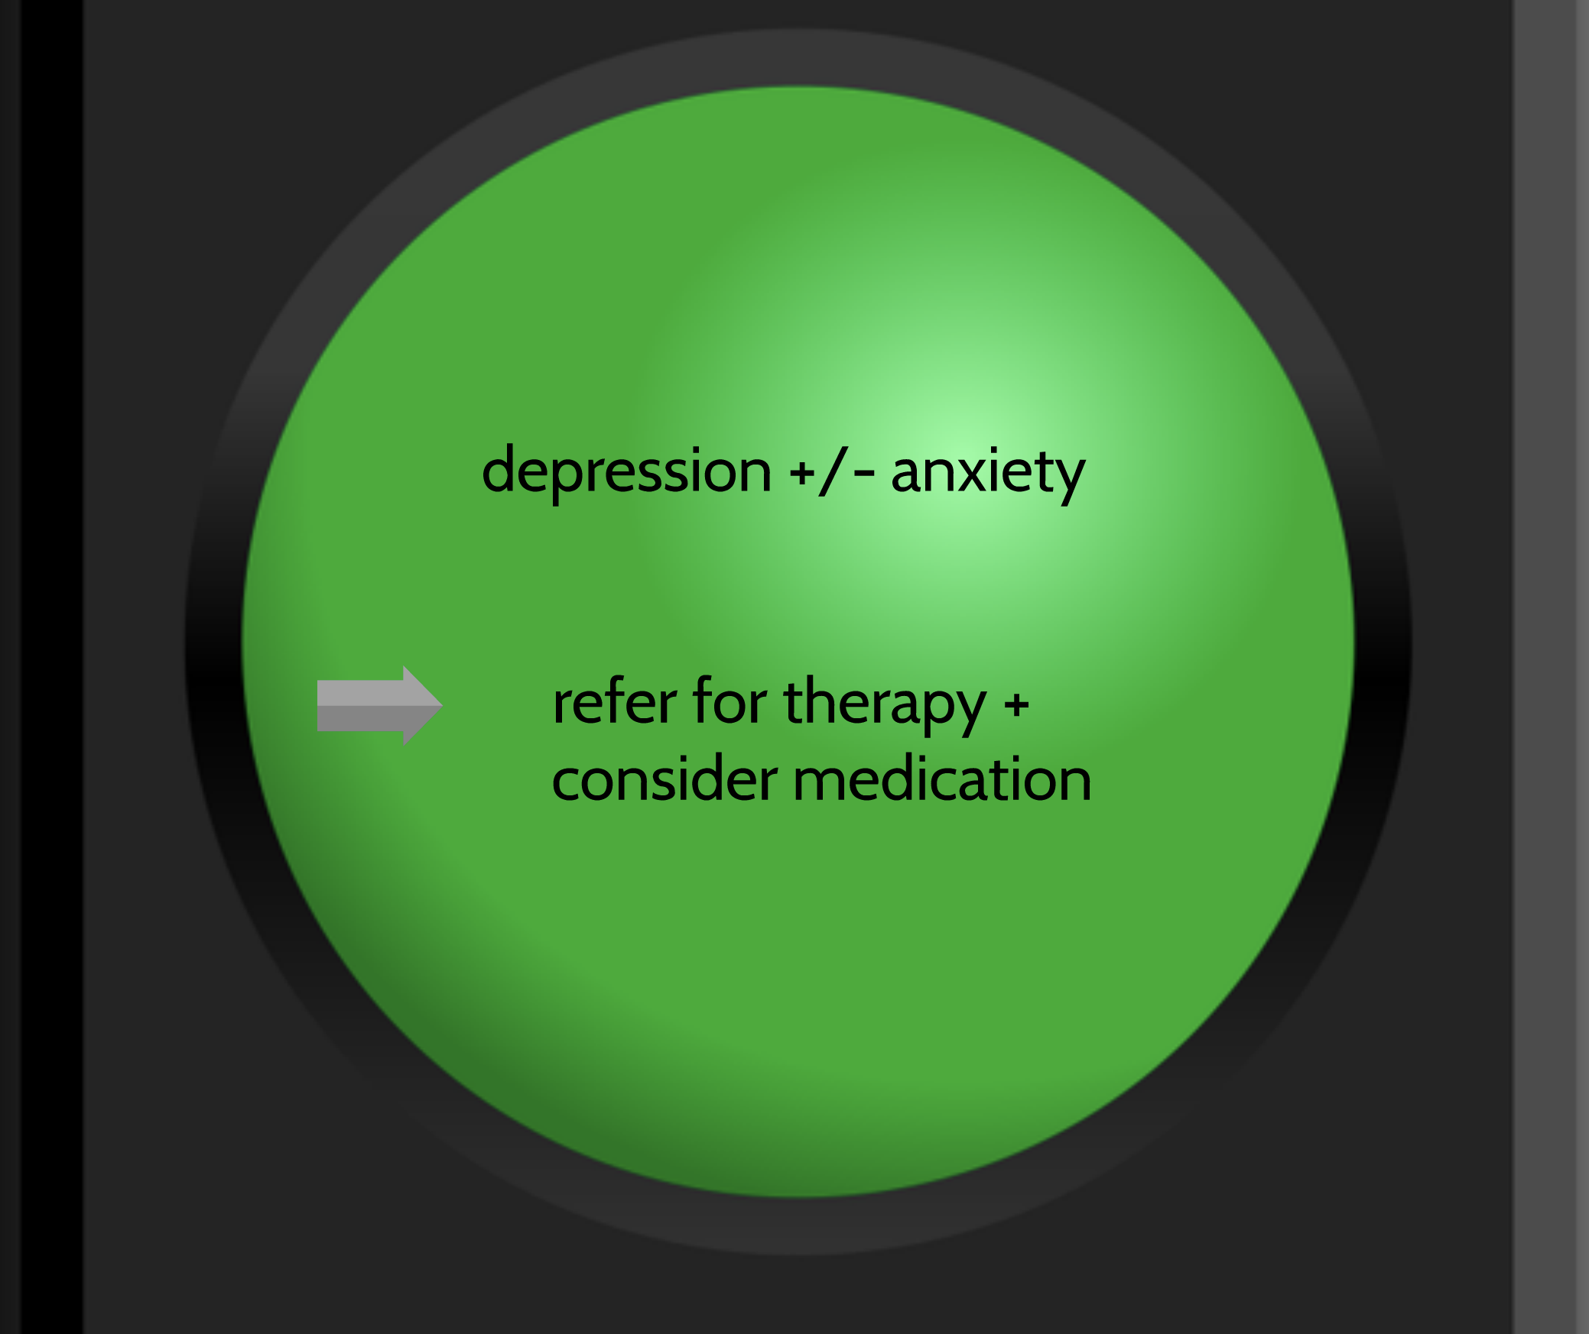

Slide 34
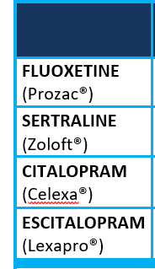
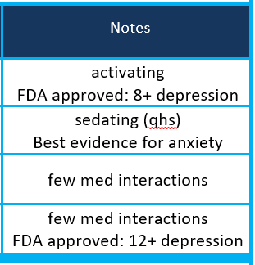

Slide 37
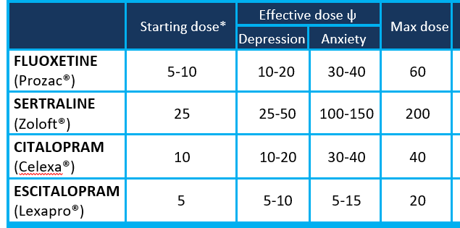

Slide 53
Changes in Practice
Implement routine screening for depression
Initiate medication treatment for adolescents with moderate severity depression
Use the PHQ-A to monitor response to treatment

